Slide 1
Module 11– Project Management + Plan + Quality
Chapters 22,23,24 of Sommerville

Slide 2
Topics covered
Risk management
Managing people
Teamwork

Slide 3
Software project management
Concerned with activities involved in ensuring
that software is delivered on time and on
schedule and in accordance with the
requirements of the organisations developing
and procuring the software.
Project management is needed because software development is always subject to budget and schedule constraints that are set by the organisation developing the software.

Slide 4
Success criteria
Deliver the software to the customer at the agreed time.
Keep overall costs within budget.
Deliver software that meets the customer’s expectations.
Maintain a coherent and well-functioning development team.

Slide 5
Software management distinctions
The product is intangible.
  Software cannot be seen or touched. Software project managers cannot see progress by simply looking at the artefact that is being constructed.
Many software projects are 'one-off' projects.
  Large software projects are usually different in some ways from previous projects. Even managers who have lots of previous experience may find it difficult to anticipate problems.
Software processes are variable and organization specific.
  We still cannot reliably predict when a particular software process is likely to lead to development problems.

Slide 6
Factors influencing project management
Company size
Software customers
Software size
Software type
Organizational culture
Software development processes
These factors mean that project managers in different organizations may work in quite different ways.

Slide 7
Universal management activities
Project planning
  Project managers are responsible for planning. estimating and scheduling project development and assigning people to tasks.
Risk management
  Project managers assess the risks that may affect a project, monitor these risks and take action when problems arise.
People management
  Project managers have to choose people for their team and establish ways of working that leads to effective team performance.

Slide 8
Management activities
Reporting
  Project managers are usually responsible for reporting on the progress of a project to customers and to the managers of the company developing the software.
Proposal writing
  The first stage in a software project may involve writing a proposal to win a contract to carry out an item of work. The proposal describes the objectives of the project and how it will be carried out.

Slide 9
Risk management

Slide 10
Risk management
Risk management is concerned with identifying risks and drawing up plans to minimise their effect on a project.
Software risk management is important because of the inherent uncertainties in software development.
  These uncertainties stem from loosely defined requirements, requirements changes due to changes in customer needs, difficulties in estimating the time and resources required for software development, and differences in individual skills.
You have to anticipate risks, understand the impact of these risks on the project, the product and the business, and take steps to avoid these risks.

Slide 11
Risk classification
There are two dimensions of risk classification
  The type of risk (technical, organizational, ..)
  what is affected by the risk:
Project risks affect schedule or resources;
Product risks affect the quality or performance of the software being developed;
Business risks affect the organisation developing or procuring the software.

Slide 12
Examples of project, product, and business risks
Risk | Affects | Description
Staff turnover | Project | Experienced staff will leave the project before it is finished.
Management change | Project | There will be a change of organizational management with different priorities.
Hardware unavailability | Project | Hardware that is essential for the project will not be delivered on schedule.
Requirements change | Project and product | There will be a larger number of changes to the requirements than anticipated.
Specification delays | Project and product | Specifications of essential interfaces are not available on schedule.
Size underestimate | Project and product | The size of the system has been underestimated.
CASE tool underperformance | Product | CASE tools, which support the project, do not perform as anticipated.
Technology change | Business | The underlying technology on which the system is built is superseded by new technology.
Product competition | Business | A competitive product is marketed before the system is completed.

Slide 13
The risk management process
Risk identification
  Identify project, product and business risks;
Risk analysis
  Assess the likelihood and consequences of these risks;
Risk planning
  Draw up plans to avoid or minimise the effects of the risk;
Risk monitoring
  Monitor the risks throughout the project;

Slide 14
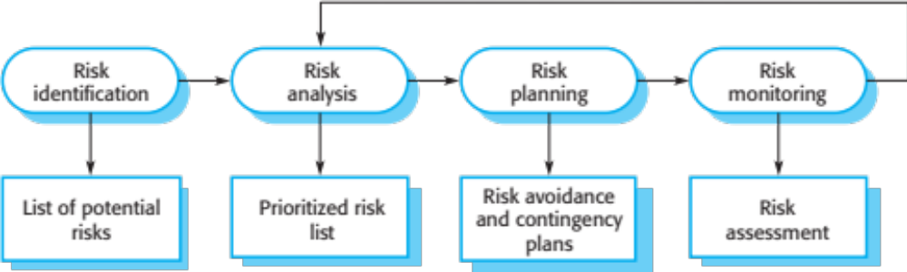
The risk management process

Slide 15
Risk identification
May be a team activities or based on the individual project manager’s experience.
A checklist of common risks may be used to identify risks in a project
  Technology risks.
  Organizational risks.
  People risks.
  Requirements risks.
  Estimation risks.

Slide 16
Examples of different risk types
Risk type | Possible risks
Estimation | The time required to develop the software is underestimated. (12) The rate of defect repair is underestimated. (13) The size of the software is underestimated. (14)
Organizational | The organization is restructured so that different management are responsible for the project. (6) Organizational financial problems force reductions in the project budget. (7)
People | It is impossible to recruit staff with the skills required. (3) Key staff are ill and unavailable at critical times. (4) Required training for staff is not available. (5)
Requirements | Changes to requirements that require major design rework are proposed. (10) Customers fail to understand the impact of requirements changes. (11)
Technology | The database used in the system cannot process as many transactions per second as expected. (1) Reusable software components contain defects that mean they cannot be reused as planned. (2)
Tools | The code generated by software code generation tools is inefficient. (8) Software tools cannot work together in an integrated way. (9)

Slide 17
Risk analysis
Assess probability and seriousness of each risk.
Probability may be very low, low, moderate, high or very high.
Risk consequences might be catastrophic, serious, tolerable or insignificant.

Slide 18
Risk types and examples
Risk | Probability | Effects
Organizational financial problems force reductions in the project budget (7). | Low | Catastrophic
It is impossible to recruit staff with the skills required for the project (3). | High | Catastrophic
Key staff are ill at critical times in the project (4). | Moderate | Serious
Faults in reusable software components have to be repaired before these components are reused. (2). | Moderate | Serious
Changes to requirements that require major design rework are proposed (10). | Moderate | Serious
The organization is restructured so that different management are responsible for the project (6). | High | Serious
The database used in the system cannot process as many transactions per second as expected (1). | Moderate | Serious

Slide 19
Risk types and examples
Risk | Probability | Effects
The time required to develop the software is underestimated (12). | High | Serious
Software tools cannot be integrated (9). | High | Tolerable
Customers fail to understand the impact of requirements changes (11). | Moderate | Tolerable
Required training for staff is not available (5). | Moderate | Tolerable
The rate of defect repair is underestimated (13). | Moderate | Tolerable
The size of the software is underestimated (14). | High | Tolerable
Code generated by code generation tools is inefficient (8). | Moderate | Insignificant

Slide 20
Risk planning
Consider each risk and develop a strategy to manage that risk.
Avoidance strategies
  The probability that the risk will arise is reduced;
Minimization strategies
  The impact of the risk on the project or product will be reduced;
Contingency plans
  If the risk arises, contingency plans are plans to deal with that risk;

Slide 21
What-if questions
What if several engineers are ill at the same time?
What if an economic downturn leads to budget cuts of 20% for the project?
What if the performance of open-source software is inadequate and the only expert on that open source software leaves?
What if the company that supplies and maintains software components goes out of business?
What if the customer fails to deliver the revised requirements as predicted?

Slide 22
Strategies to help manage risk
Risk | Strategy
Organizational financial problems | Prepare a briefing document for senior management showing how the project is making a very important contribution to the goals of the business and presenting reasons why cuts to the project budget would not be cost-effective.
Recruitment problems | Alert customer to potential difficulties and the possibility of delays; investigate buying-in components.
Staff illness | Reorganize team so that there is more overlap of work and people therefore understand each other’s jobs.
Defective components | Replace potentially defective components with bought-in components of known reliability.
Requirements changes | Derive traceability information to assess requirements change impact; maximize information hiding in the design.

Slide 23
Strategies to help manage risk
Risk | Strategy
Organizational restructuring | Prepare a briefing document for senior management showing how the project is making a very important contribution to the goals of the business.
Database performance | Investigate the possibility of buying a higher-performance database.
Underestimated development time | Investigate buying-in components; investigate use of a program generator.

Slide 24
Risk monitoring
Assess each identified risks regularly to decide whether or not it is becoming less or more probable.
Also assess whether the effects of the risk have changed.
Each key risk should be discussed at management progress meetings.

Slide 25
Risk indicators
Risk type | Potential indicators
Estimation | Failure to meet agreed schedule; failure to clear reported defects.
Organizational | Organizational gossip; lack of action by senior management.
People | Poor staff morale; poor relationships amongst team members; high staff turnover.
Requirements | Many requirements change requests; customer complaints.
Technology | Late delivery of hardware or support software; many reported technology problems.
Tools | Reluctance by team members to use tools; complaints about CASE tools; demands for higher-powered workstations.

Slide 26
Managing people

Slide 27
Managing people
People are an organisation’s most important assets.
The tasks of a manager are essentially people-oriented. Unless there is some understanding of people, management will be unsuccessful.
Poor people management is an important contributor to project failure.

Slide 28
People management factors
Consistency
  Team members should all be treated in a comparable way without favourites or discrimination.
Respect
  Different team members have different skills and these differences should be respected.
Inclusion
  Involve all team members and make sure that people’s views are considered.
Honesty
  You should always be honest about what is going well and what is going badly in a project.

Slide 29
Motivating people
An important role of a manager is to motivate the people working on a project.
Motivation means organizing the work and the working environment to encourage people to work effectively.
  If people are not motivated, they will not be interested in the work they are doing. They will work slowly, be more likely to make mistakes and will not contribute to the broader goals of the team or the organization.
Motivation is a complex issue but it appears that their are different types of motivation based on:
  Basic needs (e.g. food, sleep, etc.);
  Personal needs (e.g. respect, self-esteem);
  Social needs (e.g. to be accepted as part of a group).

Slide 30
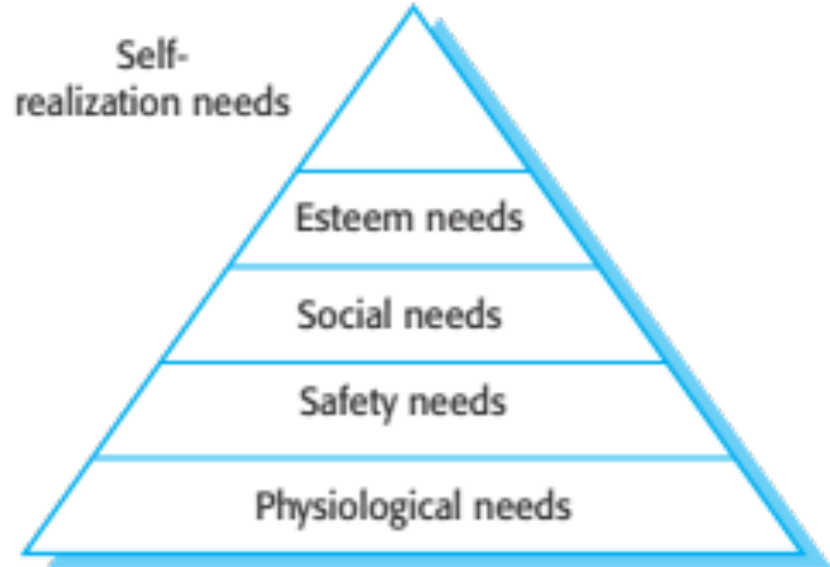
Human needs hierarchy

Slide 31
Need satisfaction
In software development groups, basic physiological and safety needs are not an issue.
Social
  Provide communal facilities;
  Allow informal communications e.g. via social networking
Esteem
  Recognition of achievements;
  Appropriate rewards.
Self-realization
  Training - people want to learn more;
  Responsibility.

Slide 32
Case study: Individual motivation
Alice is a software project manager working in a company that develops alarm systems. This company wishes to enter the growing market of assistive technology to help elderly and disabled people live independently. Alice has been asked to lead a team of 6 developers than can develop new products based around the company’s alarm technology.
Alice’s assistive technology project starts well. Good working relationships develop within the team and creative new ideas are developed. The team decides to develop a peer-to-peer messaging system using digital televisions linked to the alarm network for communications. However, some months into the project, Alice notices that Dorothy, a hardware design expert, starts coming into work late, the quality of her work deteriorates and, increasingly, that she does not appear to be communicating with other members of the team.
Alice talks about the problem informally with other team members to try to find out if Dorothy’s personal circumstances have changed, and if this might be affecting her work. They don’t know of anything, so Alice decides to talk with Dorothy to try to understand the problem.
Notes:
Just let student’s read this. Don’t try to read it out in class. Talk around the issues discussed in the book.

Slide 33
Case study: Individual motivation
After some initial denials that there is a problem, Dorothy admits that she has lost interest in the job. She expected that she would be able to develop and use her hardware interfacing skills. However, because of the product direction that has been chosen, she has little opportunity for this. Basically, she is working as a C programmer with other team members.
Although she admits that the work is challenging, she is concerned that she is not developing her interfacing skills. She is worried that finding a job that involves hardware interfacing will be difficult after this project. Because she does not want to upset the team by revealing that she is thinking about the next project, she has decided that it is best to minimize conversation with them.

Slide 34
Comments on case study
If you don’t sort out the problem of unacceptable work, the other group members will become dissatisfied and feel that they are doing an unfair share of the work.
Personal difficulties affect motivation because people can’t concentrate on their work. They need time and support to resolve these issues, although you have to make clear that they still have a responsibility to their employer.
Alice gives Dorothy more design autonomy and organizes training courses in software engineering that will give her more opportunities after her current project has finished.

Slide 35
Personality types
The needs hierarchy is almost certainly an over-simplification of motivation in practice.
Motivation should also take into account different personality types:
  Task-oriented people, who are motivated by the work they do. In software engineering.
  Interaction-oriented people, who are motivated by the presence and actions of co-workers.
  Self-oriented people, who are principally motivated by personal success and recognition.

Slide 36
Personality types
Task-oriented.
  The motivation for doing the work is the work itself;
Self-oriented.
  The work is a means to an end which is the achievement of individual goals - e.g. to get rich, to play tennis, to travel etc.;
Interaction-oriented
  The principal motivation is the presence and actions of
  co-workers. People go to work because they like to go to
  work.

Slide 37
Motivation balance
Individual motivations are made up of elements
of each class.
The balance can change depending on personal
circumstances and external events.
However, people are not just motivated by personal factors but also by being part of a group and culture.
People go to work because they are motivated by the people that they work with.

Slide 38
Teamwork

Slide 39
Teamwork
Most software engineering is a group activity
  The development schedule for most non-trivial software projects is such that they cannot be completed by one person working alone.
A good group is cohesive and has a team spirit. The people involved are motivated by the success of the group as well as by their own personal goals.
Group interaction is a key determinant of group performance.
Flexibility in group composition is limited
  Managers must do the best they can with available people.

Slide 40
Group cohesiveness
In a cohesive group, members consider the group to be more important than any individual in it.
The advantages of a cohesive group are:
  Group quality standards can be developed by the group members.
  Team members learn from each other and get to know each other’s work; Inhibitions caused by ignorance are reduced.
  Knowledge is shared. Continuity can be maintained if a group member leaves.
  Refactoring and continual improvement is encouraged. Group members work collectively to deliver high quality results and fix problems, irrespective of the individuals who originally created the design or program.

Slide 41
Team spirit
Alice, an experienced project manager, understands the importance of creating a cohesive group. As they are developing a new product, she takes the opportunity of involving all group members in the product specification and design by getting them to discuss possible technology with elderly members of their families. She also encourages them to bring these family members to meet other members of the development group.
Alice also arranges monthly lunches for everyone in the group. These lunches are an opportunity for all team members to meet informally, talk around issues of concern, and get to know each other. At the lunch, Alice tells the group what she knows about organizational news, policies, strategies, and so forth. Each team member then briefly summarizes what they have been doing and the group discusses a general topic, such as new product ideas from elderly relatives.
Every few months, Alice organizes an ‘away day’ for the group where the team spends two days on ‘technology updating’. Each team member prepares an update on a relevant technology and presents it to the group. This is an off-site meeting in a good hotel and plenty of time is scheduled for discussion and social interaction.
Notes:
Same as before – best not to read this out. Talk around the issues after students have had 2 minutes to read it.

Slide 42
The effectiveness of a team
The people in the group
  You need a mix of people in a project group as software development involves diverse activities such as negotiating with clients, programming, testing and documentation.
The group organization
  A group should be organized so that individuals can contribute to the best of their abilities and tasks can be completed as expected.
Technical and managerial communications
  Good communications between group members, and between the software engineering team and other project stakeholders, is essential.

Slide 43
Selecting group members
A manager or team leader’s job is to create a cohesive group and organize their group so that they can work together effectively.
This involves creating a group with the right balance of technical skills and personalities, and organizing that group so that the members work together effectively.

Slide 44
Assembling a team
May not be possible to appoint the ideal people to work on a project
  Project budget may not allow for the use of highly-paid staff;
  Staff with the appropriate experience may not be available;
  An organisation may wish to develop employee skills on a software project.
Managers have to work within these constraints especially when there are shortages of trained staff.

Slide 45
Group composition
Group composed of members who share the
same motivation can be problematic
  Task-oriented - everyone wants to do their own thing;
  Self-oriented - everyone wants to be the boss;
  Interaction-oriented - too much chatting, not enough work.
An effective group has a balance of all types.
This can be difficult to achieve software engineers are often task-oriented.
Interaction-oriented people are very important as they can detect and defuse tensions that arise.

Slide 46
Group composition
In creating a group for assistive technology development, Alice is aware of the importance of selecting members with complementary personalities. When interviewing potential group members, she tried to assess whether they were task-oriented, self-oriented, or interaction-oriented. She felt that she was primarily a self-oriented type because she considered the project to be a way of getting noticed by senior management and possibly promoted. She therefore looked for one or perhaps two interaction-oriented personalities, with task-oriented individuals to complete the team. The final assessment that she arrived at was:
Alice—self-oriented
Brian—task-oriented
Bob—task-oriented
Carol—interaction-oriented
Dorothy—self-oriented
Ed—interaction-oriented
Fred—task-oriented
Notes:
Same as before – discuss the issues around this rather than reading it out.

Slide 47
Group organization
The way that a group is organized affects the decisions that are made by that group, the ways that information is exchanged and the interactions between the development group and external project stakeholders.
  Key questions include:
    Should the project manager be the technical leader of the group?
    Who will be involved in making critical technical decisions, and how will these be made?
    How will interactions with external stakeholders and senior company management be handled?
    How can groups integrate people who are not co-located?
    How can knowledge be shared across the group?

Slide 48
Group organization
Small software engineering groups are usually organised informally without a rigid structure.
For large projects, there may be a hierarchical structure where different groups are responsible for different sub-projects.
Agile development is always based around an informal group on the principle that formal structure inhibits information exchange

Slide 49
Informal groups
The group acts as a whole and comes to a consensus on decisions affecting the system.
The group leader serves as the external interface of the group but does not allocate specific work items.
Rather, work is discussed by the group as a whole and tasks are allocated according to ability and experience.
This approach is successful for groups where all members are experienced and competent.

Slide 50
Group communications
Good communications are essential for effective group working.
Information must be exchanged on the status of work, design decisions and changes to previous decisions.
Good communications also strengthens group cohesion as it promotes understanding.

Slide 51
Group communications
Group size
  The larger the group, the harder it is for people to communicate with other group members.
Group structure
  Communication is better in informally structured groups than in hierarchically structured groups.
Group composition
  Communication is better when there are different personality types in a group and when groups are mixed rather than single sex.
The physical work environment
  Good workplace organisation can help encourage communications.

Slide 52
Key points
Good project management is essential if software engineering projects are to be developed on schedule and within budget.
Software management is distinct from other engineering management. Software is intangible. Projects may be novel or innovative with no body of experience to guide their management. Software processes are not as mature as traditional engineering processes.
Risk management involves identifying and assessing project risks to establish the probability that they will occur and the consequences for the project if that risk does arise. You should make plans to avoid, manage or deal with likely risks if or when they arise.

Slide 53
Key points
People management involves choosing the right people to work on a project and organizing the team and its working environment.
People are motivated by interaction with other people, the recognition of management and their peers, and by being given opportunities for personal development.
Software development groups should be fairly small and cohesive. The key factors that influence the effectiveness of a group are the people in that group, the way that it is organized and the communication between group members.
Communications within a group are influenced by factors such as the status of group members, the size of the group, the gender composition of the group, personalities and available communication channels.

Slide 55
Chapter 23 – Project planning

Slide 56
Topics covered
Software pricing
Plan-driven development
Project scheduling
Agile planning
Estimation techniques
COCOMO cost modeling

Slide 57
Project planning
Project planning involves breaking down the work into parts and assign these to project team members, anticipate problems that might arise and prepare tentative solutions to those problems.
The project plan, which is created at the start of a project, is used to communicate how the work will be done to the project team and customers, and to help assess progress on the project.

Slide 58
Planning stages
At the proposal stage, when you are bidding for a contract to develop or provide a software system.
During the project startup phase, when you have to plan who will work on the project, how the project will be broken down into increments, how resources will be allocated across your company, etc.
Periodically throughout the project, when you modify your plan in the light of experience gained and information from monitoring the progress of the work.

Slide 59
Proposal planning
Planning may be necessary with only outline software requirements.
The aim of planning at this stage is to provide information that will be used in setting a price for the system to customers.
Project pricing involves estimating how much the software will cost to develop, taking factors such as staff costs, hardware costs, software costs, etc. into account

Slide 60
Project startup planning
At this stage, you know more about the system requirements but do not have design or implementation information
Create a plan with enough detail to make decisions about the project budget and staffing.
  This plan is the basis for project resource allocation
The startup plan should also define project monitoring mechanisms
A startup plan is still needed for agile development to allow resources to be allocated to the project

Slide 61
Development planning
The project plan should be regularly amended as the project progresses and you know more about the software and its development
The project schedule, cost-estimate and risks have to be regularly revised

Slide 62
Software pricing

Slide 63
Software pricing
Estimates are made to discover the cost, to the developer, of producing a software system.
  You take into account, hardware, software, travel, training and effort costs.
There is not a simple relationship between the development cost and the price charged to the customer.
Broader organisational, economic, political and business considerations influence the price charged.

Slide 64
Factors affecting software pricing
Factor | Description
Contractual terms | A customer may be willing to allow the developer to retain ownership of the source code and reuse it in other projects. The price charged may then be less than if the software source code is handed over to the customer.
Cost estimate uncertainty | If an organization is unsure of its cost estimate, it may increase its price by a contingency over and above its normal profit.
Financial health | Developers in financial difficulty may lower their price to gain a contract. It is better to make a smaller than normal profit or break even than to go out of business. Cash flow is more important than profit in difficult economic times.

Slide 65
Factors affecting software pricing
Factor | Description
Market opportunity | A development organization may quote a low price because it wishes to move into a new segment of the software market. Accepting a low profit on one project may give the organization the opportunity to make a greater profit later. The experience gained may also help it develop new products.
Requirements volatility | If the requirements are likely to change, an organization may lower its price to win a contract. After the contract is awarded, high prices can be charged for changes to the requirements.

Slide 66
Pricing strategies
Under pricing
  A company may underprice a system in order to gain a contract that allows them to retain staff for future opportunities
  A company may underprice a system to gain access to a new market area
Increased pricing
  The price may be increased when a buyer wishes a fixed-price contract and so the seller increases the price to allow for unexpected risks

Slide 67
Pricing to win
The software is priced according to what the software developer believes the buyer is willing to pay
If this is less that the development costs, the software functionality may be reduced accordingly with a view to extra functionality being added in a later release
Additional costs may be added as the requirements change and these may be priced at a higher level to make up the shortfall in the original price

Slide 68
Plan-driven development

Slide 69
Plan-driven development
Plan-driven or plan-based development is an approach to software engineering where the development process is planned in detail.
  Plan-driven development is based on engineering project management techniques and is the ‘traditional’ way of managing large software development projects.
A project plan is created that records the work to be done, who will do it, the development schedule and the work products.
Managers use the plan to support project decision making and as a way of measuring progress.

Slide 70
Plan-driven development – pros and cons
The arguments in favor of a plan-driven approach are that early planning allows organizational issues (availability of staff, other projects, etc.) to be closely taken into account, and that potential problems and dependencies are discovered before the project starts, rather than once the project is underway.
The principal argument against plan-driven development is that many early decisions have to be revised because of changes to the environment in which the software is to be developed and used.

Slide 71
Project plans
In a plan-driven development project, a project plan sets out the resources available to the project, the work breakdown and a schedule for carrying out the work.
Plan sections
  Introduction
  Project organization
  Risk analysis
  Hardware and software resource requirements
  Work breakdown
  Project schedule
  Monitoring and reporting mechanisms

Slide 72
Project plan supplements
Plan | Description
Configuration management plan | Describes the configuration management procedures and structures to be used.
Deployment plan | Describes how the software and associated hardware (if required) will be deployed in the customer’s environment. This should include a plan for migrating data from existing systems.
Maintenance plan | Predicts the maintenance requirements, costs, and effort.
Quality plan | Describes the quality procedures and standards that will be used in a project.
Validation plan | Describes the approach, resources, and schedule used for system validation.

Slide 73
The planning process
Project planning is an iterative process that starts when you create an initial project plan during the project startup phase.
Plan changes are inevitable.
  As more information about the system and the project team becomes available during the project, you should regularly revise the plan to reflect requirements, schedule and risk changes.
  Changing business goals also leads to changes in project plans. As business goals change, this could affect all projects, which may then have to be re-planned.

Slide 74
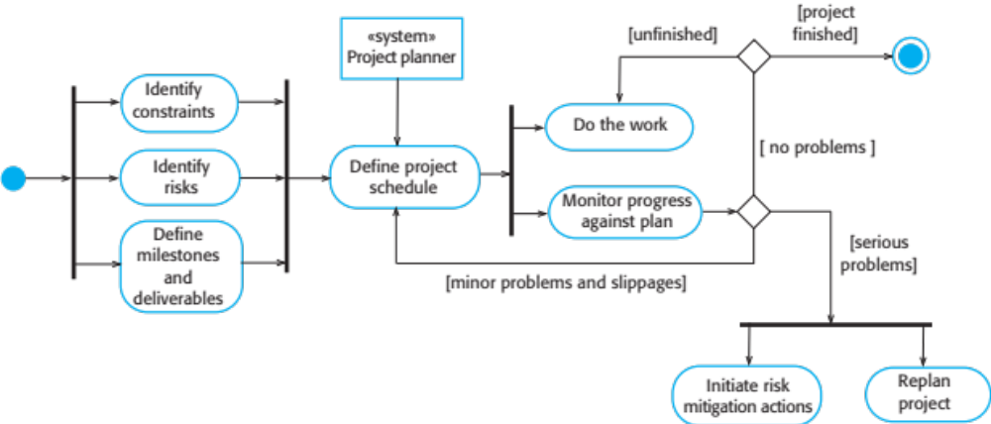
The project planning process

Slide 75
Planning assumptions
You should make realistic rather than optimistic assumptions when you are defining a project plan.
Problems of some description always arise during a project, and these lead to project delays.
Your initial assumptions and scheduling should therefore take unexpected problems into account.
You should include contingency in your plan so that if things go wrong, then your delivery schedule is not seriously disrupted.

Slide 76
Risk mitigation
If there are serious problems with the development work that are likely to lead to significant delays, you need to initiate risk mitigation actions to reduce the risks of project failure.
In conjunction with these actions, you also have to re-plan the project.
This may involve renegotiating the project constraints and deliverables with the customer. A new schedule of when work should be completed also has to be established and agreed with the customer.

Slide 77
Project scheduling

Slide 78
Project scheduling
Project scheduling is the process of deciding how the work in a project will be organized as separate tasks, and when and how these tasks will be executed.
You estimate the calendar time needed to complete each task, the effort required and who will work on the tasks that have been identified.
You also have to estimate the resources needed to complete each task, such as the disk space required on a server, the time required on specialized hardware, such as a simulator, and what the travel budget will be.

Slide 79
Project scheduling activities
Split project into tasks and estimate time and resources required to complete each task.
Organize tasks concurrently to make optimal
use of workforce.
Minimize task dependencies to avoid delays
caused by one task waiting for another to complete.
Dependent on project managers intuition and experience.

Slide 80
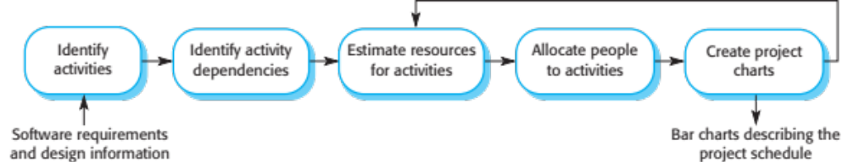
The project scheduling process

Slide 81
Scheduling problems
Estimating the difficulty of problems and hence the cost of developing a solution is hard.
Productivity is not proportional to the number of people working on a task.
Adding people to a late project makes it later because of communication overheads.
The unexpected always happens. Always allow contingency in planning.

Slide 82
Schedule presentation
Graphical notations are normally used to illustrate the project schedule.
These show the project breakdown into tasks. Tasks should not be too small. They should take about a week or two.
Calendar-based
  Bar charts are the most commonly used representation for project schedules. They show the schedule as activities or resources against time.
Activity networks
  Show task dependencies

Slide 83
Project activites
Project activities (tasks) are the basic planning element. Each activity has:
  a duration in calendar days or months,
  an effort estimate, which shows the number of person-days or person-months to complete the work,
  a deadline by which the activity should be complete,
  a defined end-point, which might be a document, the holding of a review meeting, the successful execution of all tests, etc.

Slide 84
Milestones and deliverables
Milestones are points in the schedule against which you can assess progress, for example, the handover of the system for testing.
Deliverables are work products that are delivered to the customer, e.g. a requirements document for the system.

Slide 85
Tasks, durations, and dependencies
Task | Effort (person-days) | Duration (days) | Dependencies
T1 | 15 | 10
T2 | 8 | 15
T3 | 20 | 15 | T1 (M1)
T4 | 5 | 10
T5 | 5 | 10 | T2, T4 (M3)
T6 | 10 | 5 | T1, T2 (M4)
T7 | 25 | 20 | T1 (M1)
T8 | 75 | 25 | T4 (M2)
T9 | 10 | 15 | T3, T6 (M5)
T10 | 20 | 15 | T7, T8 (M6)
T11 | 10 | 10 | T9 (M7)
T12 | 20 | 10 | T10, T11 (M8)

Slide 86
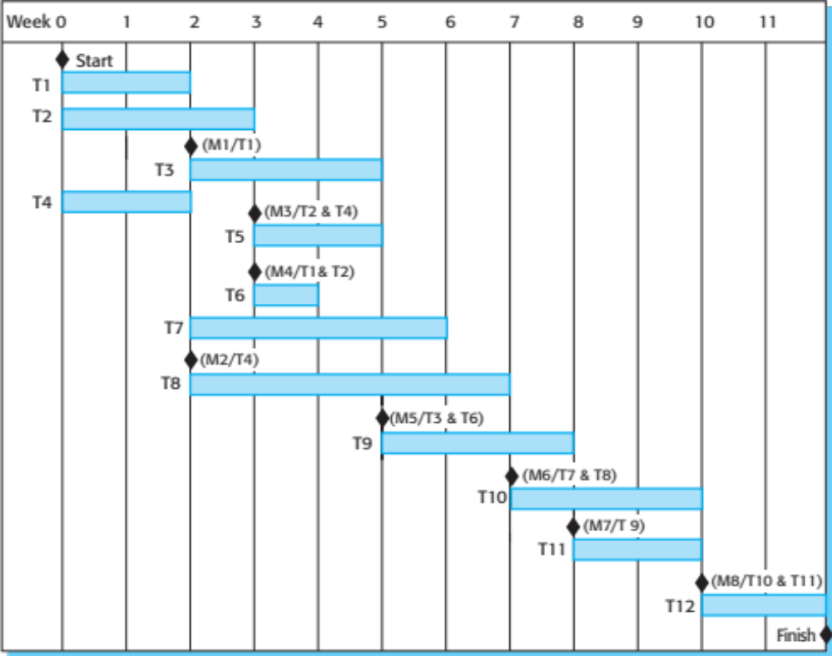
Activity bar chart

Slide 87
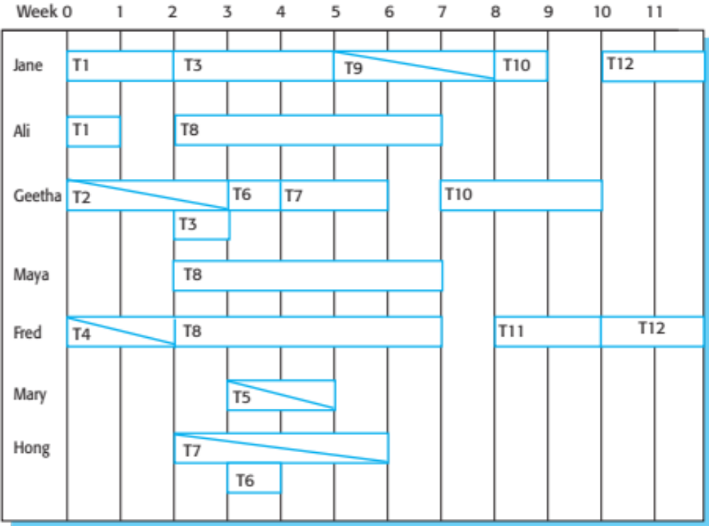
Staff allocation chart

Slide 88
Agile planning

Slide 89
Agile planning
Agile methods of software development are iterative approaches where the software is developed and delivered to customers in increments.
Unlike plan-driven approaches, the functionality of these increments is not planned in advance but is decided during the development.
  The decision on what to include in an increment depends on progress and on the customer’s priorities.
The customer’s priorities and requirements change so it makes sense to have a flexible plan that can accommodate these changes.

Slide 90
Agile planning stages
Release planning, which looks ahead for several months and decides on the features that should be included in a release of a system.
Iteration planning, which has a shorter term outlook, and focuses on planning the next increment of a system. This is typically 2-4 weeks of work for the team.

Slide 91
Approaches to agile planning
Planning in Scrum
  Covered in Chapter 3
Based on managing a project backlog (things to be done) with daily reviews of progress and problems
The planning game
  Developed originally as part of Extreme Programming (XP)
  Dependent on user stories as a measure of progress in the project

Slide 92
Story-based planning
The planning game is based on user stories that reflect the features that should be included in the system.
The project team read and discuss the stories and rank them in order of the amount of time they think it will take to implement the story.
Stories are assigned ‘effort points’ reflecting their size and difficulty of implementation
The number of effort points implemented per day is measured giving an estimate of the team’s ‘velocity’
This allows the total effort required to implement the system to be estimated

Slide 93
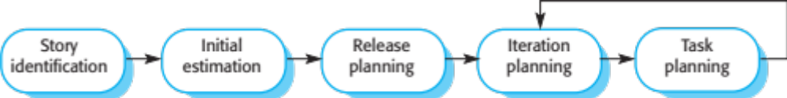
The planning game

Slide 94
Release and iteration planning
Release planning involves selecting and refining the stories that will reflect the features to be implemented in a release of a system and the order in which the stories should be implemented.
Stories to be implemented in each iteration are chosen, with the number of stories reflecting the time to deliver an iteration (usually 2 or 3 weeks).
The team’s velocity is used to guide the choice of stories so that they can be delivered within an iteration.

Slide 95
Task allocation
During the task planning stage, the developers break down stories into development tasks.
  A development task should take 4–16 hours.
  All of the tasks that must be completed to implement all of the stories in that iteration are listed.
  The individual developers then sign up for the specific tasks that they will implement.
Benefits of this approach:
  The whole team gets an overview of the tasks to be completed in an iteration.
  Developers have a sense of ownership in these tasks and this is likely to motivate them to complete the task.

Slide 96
Software delivery
A software increment is always delivered at the end of each project iteration.
If the features to be included in the increment cannot be completed in the time allowed, the scope of the work is reduced.
The delivery schedule is never extended.

Slide 97
Agile planning difficulties
Agile planning is reliant on customer involvement and availability.
This can be difficult to arrange, as customer representatives sometimes have to prioritize other work and are not available for the planning game.
Furthermore, some customers may be more familiar with traditional project plans and may find it difficult to engage in an agile planning process.

Slide 98
Agile planning applicability
Agile planning works well with small, stable development teams that can get together and discuss the stories to be implemented.
However, where teams are large and/or geographically distributed, or when team membership changes frequently, it is practically impossible for everyone to be involved in the collaborative planning that is essential for agile project management.

Slide 99
Estimation techniques

Slide 100
Estimation techniques
Organizations need to make software effort and cost estimates. There are two types of technique that can be used to do this:
  Experience-based techniques The estimate of future effort requirements is based on the manager’s experience of past projects and the application domain. Essentially, the manager makes an informed judgment of what the effort requirements are likely to be.
  Algorithmic cost modeling In this approach, a formulaic approach is used to compute the project effort based on estimates of product attributes, such as size, and process characteristics, such as experience of staff involved.

Slide 101
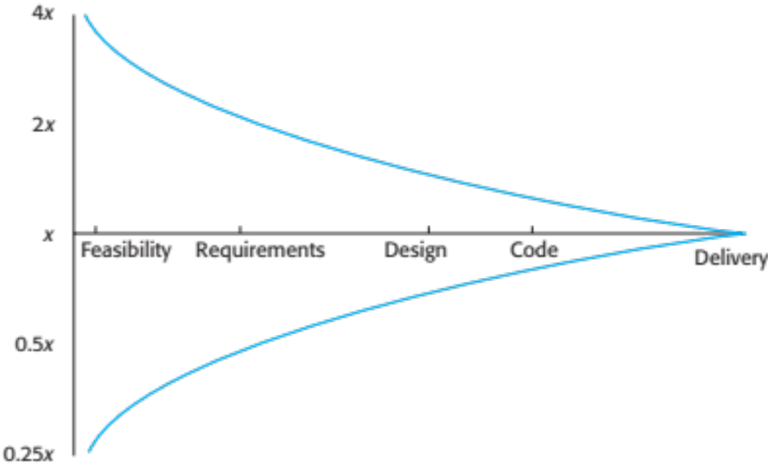
Estimate uncertainty

Slide 102
Experience-based approaches
Experience-based techniques rely on judgments based on experience of past projects and the effort expended in these projects on software development activities.
Typically, you identify the deliverables to be produced in a project and the different software components or systems that are to be developed.
You document these in a spreadsheet, estimate them individually and compute the total effort required.
It usually helps to get a group of people involved in the effort estimation and to ask each member of the group to explain their estimate.

Slide 103
Problem with experience-based approaches
The difficulty with experience-based techniques is that a new software project may not have much in common with previous projects.
Software development changes very quickly and a project will often use unfamiliar techniques such as web services, application system configuration or HTML5.
If you have not worked with these techniques, your previous experience may not help you to estimate the effort required, making it more difficult to produce accurate costs and schedule estimates.

Slide 104
Algorithmic cost modelling
Cost is estimated as a mathematical function of
product, project and process attributes whose
values are estimated by project managers:
  Effort = A × Size^{B} × M
  A is an organisation-dependent constant, B reflects the disproportionate effort for large projects and M is a multiplier reflecting product, process and people attributes.
The most commonly used product attribute for cost
estimation is code size.
Most models are similar but they use different values for A, B and M.

Slide 105
Estimation accuracy
The size of a software system can only be known accurately when it is finished.
Several factors influence the final size
  Use of reused systems and components;
  Programming language;
  Distribution of system.
As the development process progresses then the size estimate becomes more accurate.
The estimates of the factors contributing to B and M are subjective and vary according to the judgment of the estimator.

Slide 106
Effectiveness of algorithmic models
Algorithmic cost models are a systematic way to estimate the effort required to develop a system. However, these models are complex and difficult to use.
There are many attributes and considerable scope for uncertainty in estimating their values.
This complexity means that the practical application of algorithmic cost modeling has been limited to a relatively small number of large companies, mostly working in defense and aerospace systems engineering.

Slide 107
COCOMO cost modeling

Slide 108
COCOMO cost modeling
An empirical model based on project experience.
Well-documented, ‘independent’ model which is not tied to a specific software vendor.
Long history from initial version published in 1981 (COCOMO-81) through various instantiations to COCOMO 2.
COCOMO 2 takes into account different approaches to software development, reuse, etc.

Slide 109
COCOMO 2 models
COCOMO 2 incorporates a range of sub-models that produce increasingly detailed software estimates.
The sub-models in COCOMO 2 are:
  Application composition model. Used when software is composed from existing parts.
  Early design model. Used when requirements are available but design has not yet started.
  Reuse model. Used to compute the effort of integrating reusable components.
  Post-architecture model. Used once the system architecture has been designed and more information about the system is available.

Slide 110
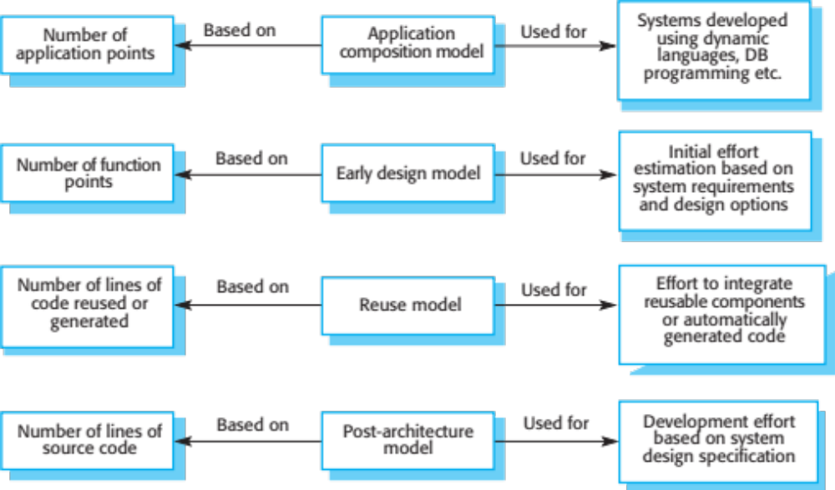
COCOMO estimation models

Slide 111
Application composition model
Supports prototyping projects and projects where there is extensive reuse.
Based on standard estimates of developer productivity in application (object) points/month.
Takes software tool use into account.
Formula is
  PM = ( NAP × (1 - %reuse/100 ) ) / PROD
  PM is the effort in person-months, NAP is the number of application points and PROD is the productivity.

Slide 112
Application-point productivity
Developer’s experience and capability | Very low | Low | Nominal | High | Very high
ICASE maturity and capability | Very low | Low | Nominal | High | Very high
PROD (NAP/month) | 4 | 7 | 13 | 25 | 50

Slide 113
Early design model
Estimates can be made after the requirements have been agreed.
Based on a standard formula for algorithmic models
PM = A × Size^{B} × M where
  M = PERS × RCPX × RUSE × PDIF × PREX × FCIL × SCED;
  A = 2.94 in initial calibration,
  Size in KLOC,
  B varies from 1.1 to 1.24 depending on novelty of the project, development flexibility, risk management approaches and the process maturity.

Slide 114
Multipliers
Multipliers reflect the capability of the developers, the non-functional requirements, the familiarity with the development platform, etc.
  RCPX - product reliability and complexity;
  RUSE - the reuse required;
  PDIF - platform difficulty;
  PREX - personnel experience;
  PERS - personnel capability;
  SCED - required schedule;
  FCIL - the team support facilities.

Slide 115
The reuse model
Takes into account black-box code that is reused without change and code that has to be adapted to integrate it with new code.
There are two versions:
  Black-box reuse where code is not modified. An effort estimate (PM) is computed.
  White-box reuse where code is modified. A size estimate equivalent to the number of lines of new source code is computed. This then adjusts the size estimate for new code.

Slide 116
Reuse model estimates 1
For generated code:
PM = (ASLOC * AT/100)/ATPROD
  ASLOC is the number of lines of generated code
  AT is the percentage of code automatically generated.
  ATPROD is the productivity of engineers in integrating this code.

Slide 117
Reuse model estimates 2
When code has to be understood and integrated:
ESLOC = ASLOC * (1-AT/100) * AAM.
  ASLOC and AT as before.
  AAM is the adaptation adjustment multiplier computed from the costs of changing the reused code, the costs of understanding how to integrate the code and the costs of reuse decision making.

Slide 118
Post-architecture level
Uses the same formula as the early design model but with 17 rather than 7 associated multipliers.
The code size is estimated as:
  Number of lines of new code to be developed;
  Estimate of equivalent number of lines of new code computed using the reuse model;
  An estimate of the number of lines of code that have to be modified according to requirements changes.

Slide 119
The exponent term
This depends on 5 scale factors (see next slide). Their sum/100 is added to 1.01
A company takes on a project in a new domain. The client has not defined the process to be used and has not allowed time for risk analysis. The company has a CMM level 2 rating.
  Precedenteness - new project (4)
  Development flexibility - no client involvement - Very high (1)
  Architecture/risk resolution - No risk analysis - V. Low .(5)
  Team cohesion - new team - nominal (3)
  Process maturity - some control - nominal (3)
Scale factor is therefore 1.17.

Slide 120
Scale factors used in the exponent computation in the post-architecture model
Scale factor | Explanation
Architecture/risk resolution | Reflects the extent of risk analysis carried out. Very low means little analysis; extra-high means a complete and thorough risk analysis.
Development flexibility | Reflects the degree of flexibility in the development process. Very low means a prescribed process is used; extra-high means that the client sets only general goals.
Precedentedness | Reflects the previous experience of the organization with this type of project. Very low means no previous experience; extra-high means that the organization is completely familiar with this application domain.
Process maturity | Reflects the process maturity of the organization. The computation of this value depends on the CMM Maturity Questionnaire, but an estimate can be achieved by subtracting the CMM process maturity level from 5.
Team cohesion | Reflects how well the development team knows each other and work together. Very low means very difficult interactions; extra-high means an integrated and effective team with no communication problems.

Slide 121
Multipliers
Product attributes
  Concerned with required characteristics of the software product being developed.
Computer attributes
  Constraints imposed on the software by the hardware platform.
Personnel attributes
  Multipliers that take the experience and capabilities of the people working on the project into account.
Project attributes
  Concerned with the particular characteristics of the software development project.

Slide 122
The effect of cost drivers on effort estimates
Exponent value | 1.17
System size (including factors for reuse and requirements volatility) | 128,000 DSI
Initial COCOMO estimate without cost drivers | 730 person-months
Reliability | Very high, multiplier = 1.39
Complexity | Very high, multiplier = 1.3
Memory constraint | High, multiplier = 1.21
Tool use | Low, multiplier = 1.12
Schedule | Accelerated, multiplier = 1.29
Adjusted COCOMO estimate | 2,306 person-months

Slide 123
The effect of cost drivers on effort estimates
Exponent value | 1.17
Reliability | Very low, multiplier = 0.75
Complexity | Very low, multiplier = 0.75
Memory constraint | None, multiplier = 1
Tool use | Very high, multiplier = 0.72
Schedule | Normal, multiplier = 1
Adjusted COCOMO estimate | 295 person-months

Slide 124
Project duration and staffing
As well as effort estimation, managers must estimate the calendar time required to complete a project and when staff will be required.
Calendar time can be estimated using a COCOMO 2 formula
  TDEV = 3 × (PM)^{(0.33+0.2*(B-1.01))}
  PM is the effort computation and B is the exponent computed as discussed above (B is 1 for the early prototyping model). This computation predicts the nominal schedule for the project.
The time required is independent of the number of people working on the project.

Slide 125
Staffing requirements
Staff required can’t be computed by diving the development time by the required schedule.
The number of people working on a project varies depending on the phase of the project.
The more people who work on the project, the more total effort is usually required.
A very rapid build-up of people often correlates with schedule slippage.

Slide 126
Key points
The price charged for a system does not just depend on its estimated development costs and the profit required by the development company. Organizational factors may mean that the price is increased to compensate for increased risk or decreased to gain competitive advantage.
Software is often priced to gain a contract and the functionality of the system is then adjusted to meet the estimated price.
Plan-driven development is organized around a complete project plan that defines the project activities, the planned effort, the activity schedule and who is responsible for each activity.

Slide 127
Key points
Project scheduling involves the creation of various graphical representations of part of the project plan. Bar charts, which show the activity duration and staffing timelines, are the most commonly used schedule representations.
A project milestone is a predictable outcome of an activity or set of activities. At each milestone, a formal report of progress should be presented to management. A deliverable is a work product that is delivered to the project customer.
The agile planning game involves the whole team in project planning. The plan is developed incrementally and, if problems arise, it is adjusted so that software functionality is reduced instead of delaying the delivery of an increment.

Slide 128
Key points
Estimation techniques for software may be experience-based, where managers judge the effort required, or algorithmic, where the effort required is computed from other estimated project parameters.
The COCOMO II costing model is a mature algorithmic cost model that takes project, product, hardware and personnel attributes into account when formulating a cost estimate.

Slide 130
Chapter 24 - Quality Management

Slide 131
Topics covered
Software quality
Software standards
Reviews and inspections
Quality management and agile development
Software measurement

Slide 132
Software quality management
Concerned with ensuring that the required level of quality is achieved in a software product.
Three principal concerns:
  At the organizational level, quality management is concerned with establishing a framework of organizational processes and standards that will lead to high-quality software.
  At the project level, quality management involves the application of specific quality processes and checking that these planned processes have been followed.
  At the project level, quality management is also concerned with establishing a quality plan for a project. The quality plan should set out the quality goals for the project and define what processes and standards are to be used.

Slide 133
Quality management activities
Quality management provides an independent check on the software development process.
The quality management process checks the project deliverables to ensure that they are consistent with organizational standards and goals
The quality team should be independent from the development team so that they can take an objective view of the software. This allows them to report on software quality without being influenced by software development issues.

Slide 134
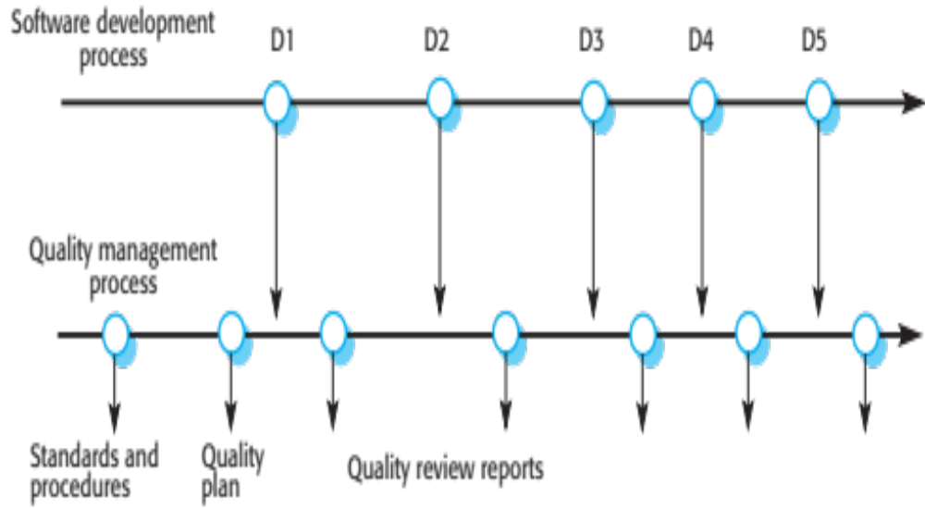
Quality management and software development

Slide 135
Quality planning
A quality plan sets out the desired product qualities and how these are assessed and defines the most significant quality attributes.
The quality plan should define the quality assessment process.
It should set out which organisational standards should be applied and, where necessary, define new standards to be used.

Slide 136
Quality plans
Quality plan structure
  Product introduction;
  Product plans;
  Process descriptions;
  Quality goals;
  Risks and risk management.
Quality plans should be short, succinct documents
  If they are too long, no-one will read them.

Slide 137
Scope of quality management
Quality management is particularly important for large, complex systems. The quality documentation is a record of progress and supports continuity of development as the development team changes.
For smaller systems, quality management needs less documentation and should focus on establishing a quality culture.
Techniques have to evolve when agile development is used.

Slide 138
Software quality

Slide 139
Software quality
Quality, simplistically, means that a product should meet its specification.
This is problematical for software systems
  There is a tension between customer quality requirements (efficiency, reliability, etc.) and developer quality requirements (maintainability, reusability, etc.);
  Some quality requirements are difficult to specify in an unambiguous way;
  Software specifications are usually incomplete and often inconsistent.
The focus may be ‘fitness for purpose’ rather than specification conformance.

Slide 140
Software fitness for purpose
Has the software been properly tested?
Is the software sufficiently dependable to be put into use?
Is the performance of the software acceptable for normal use?
Is the software usable?
Is the software well-structured and understandable?
Have programming and documentation standards been followed in the development process?

Slide 141
Non-functional characteristics
The subjective quality of a software system is largely based on its non-functional characteristics.
This reflects practical user experience – if the software’s functionality is not what is expected, then users will often just work around this and find other ways to do what they want to do.
However, if the software is unreliable or too slow, then it is practically impossible for them to achieve their goals.

Slide 142
Software quality attributes
Safety | Understandability | Portability
Security | Testability | Usability
Reliability | Adaptability | Reusability
Resilience | Modularity | Efficiency
Robustness | Complexity | Learnability

Slide 143
Quality conflicts
It is not possible for any system to be optimized for all of these attributes – for example, improving robustness may lead to loss of performance.
The quality plan should therefore define the most important quality attributes for the software that is being developed.
The plan should also include a definition of the quality assessment process, an agreed way of assessing whether some quality, such as maintainability or robustness, is present in the product.

Slide 144
Process and product quality
The quality of a developed product is influenced by the quality of the production process.
This is important in software development as some product quality attributes are hard to assess.
However, there is a very complex and poorly understood relationship between software processes and product quality.
  The application of individual skills and experience is particularly important in software development;
  External factors such as the novelty of an application or the need for an accelerated development schedule may impair product quality.

Slide 145
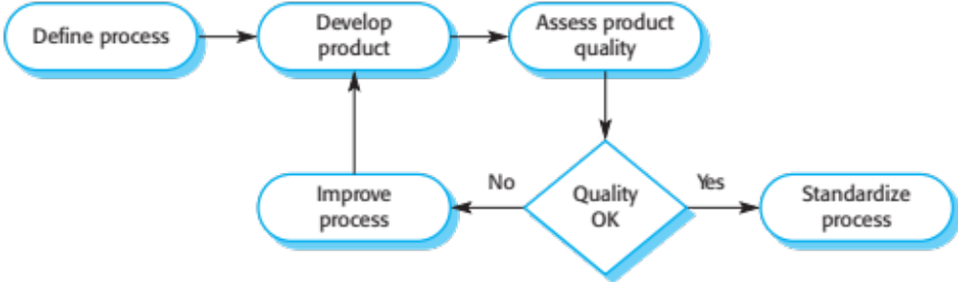
Process-based quality

Slide 146
Quality culture
Quality managers should aim to develop a ‘quality culture’ where everyone responsible for software development is committed to achieving a high level of product quality.
They should encourage teams to take responsibility for the quality of their work and to develop new approaches to quality improvement.
They should support people who are interested in the intangible aspects of quality and encourage professional behavior in all team members.

Slide 147
Software standards

Slide 148
Software standards
Standards define the required attributes of a product or process. They play an important role in quality management.
Standards may be international, national, organizational or project standards.

Slide 149
Importance of standards
Encapsulation of best practice- avoids repetition of past mistakes.
They are a framework for defining what quality means in a particular setting i.e. that organization’s view of quality.
They provide continuity - new staff can understand the organisation by understanding the standards that are used.

Slide 150
Product and process standards
Product standards
  Apply to the software product being developed. They include document standards, such as the structure of requirements documents, documentation standards, such as a standard comment header for an object class definition, and coding standards, which define how a programming language should be used.
Process standards
  These define the processes that should be followed during software development. Process standards may include definitions of specification, design and validation processes, process support tools and a description of the documents that should be written during these processes.

Slide 151
Product and process standards
Product standards | Process standards
Design review form | Design review conduct
Requirements document structure | Submission of new code for system building
Method header format | Version release process
Java programming style | Project plan approval process
Project plan format | Change control process
Change request form | Test recording process

Slide 152
Problems with standards
They may not be seen as relevant and up-to-date by software engineers.
They often involve too much bureaucratic form filling.
If they are unsupported by software tools, tedious form filling work is often involved to maintain the documentation associated with the standards.

Slide 153
Standards development
Involve practitioners in development. Engineers should understand the rationale underlying a standard.
Review standards and their usage regularly.
Standards can quickly become outdated and this reduces their credibility amongst practitioners.
Detailed standards should have specialized tool
support. Excessive clerical work is the most
significant complaint against standards.
  Web-based forms are not good enough.

Slide 154
ISO 9001 standards framework
An international set of standards that can be used as a basis for developing quality management systems.
ISO 9001, the most general of these standards, applies to organizations that design, develop and maintain products, including software.
The ISO 9001 standard is a framework for developing software standards.
  It sets out general quality principles, describes quality processes in general and lays out the organizational standards and procedures that should be defined. These should be documented in an organizational quality manual.

Slide 155
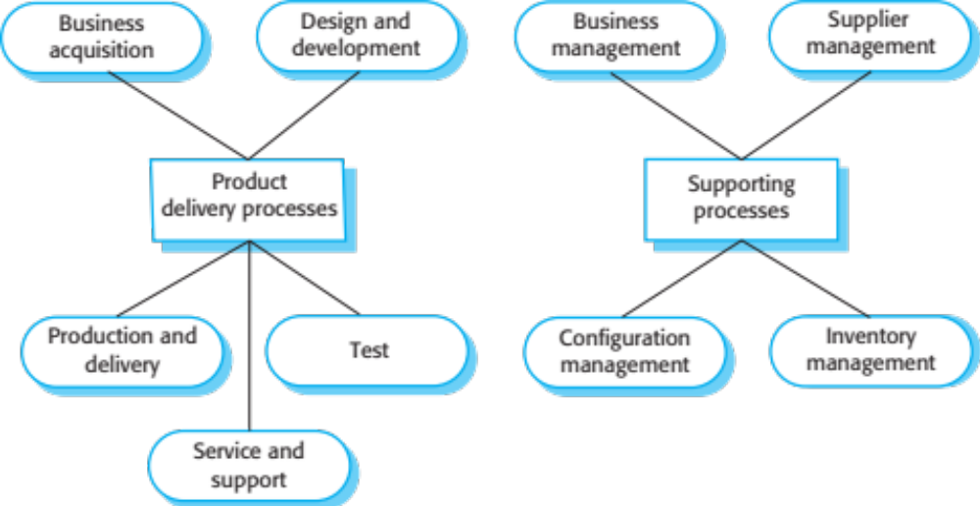
ISO 9001 core processes

Slide 156
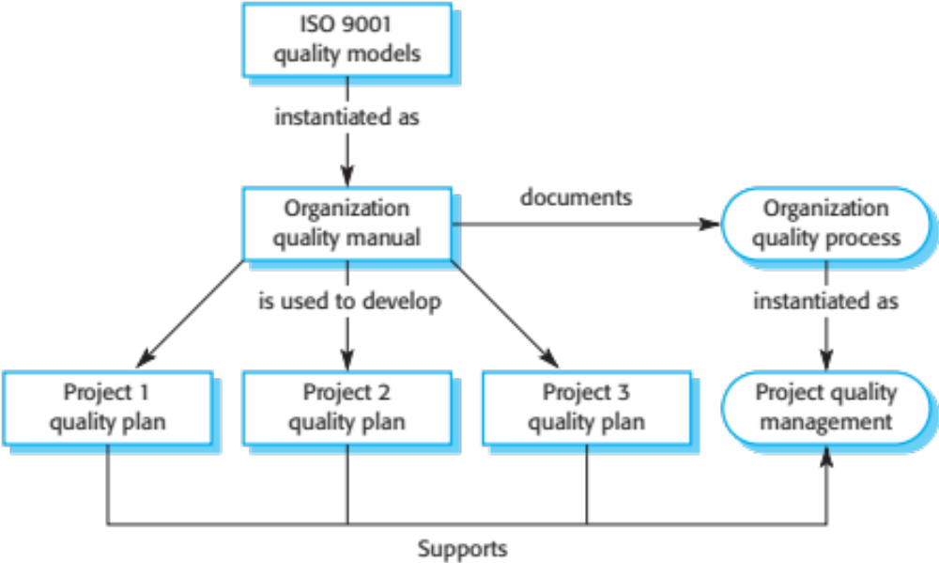
ISO 9001 and quality management

Slide 157
ISO 9001 certification
Quality standards and procedures should be documented in an organisational quality manual.
An external body may certify that an organisation’s quality manual conforms to ISO 9000 standards.
Some customers require suppliers to be ISO 9000 certified although the need for flexibility here is increasingly recognised.

Slide 158
Software quality and ISO9001
The ISO 9001 certification is inadequate because it defines quality to be the conformance to standards.
It takes no account of quality as experienced by users of the software. For example, a company could define test coverage standards specifying that all methods in objects must be called at least once.
Unfortunately, this standard can be met by incomplete software testing that does not include tests with different method parameters. So long as the defined testing procedures are followed and test records maintained, the company could be ISO 9001 certified.

Slide 159
Reviews and inspections

Slide 160
Reviews and inspections
A group examines part or all of a process or system and its documentation to find potential problems.
Software or documents may be 'signed off' at a
review which signifies that progress to the next
development stage has been approved by
management.
There are different types of review with different objectives
  Inspections for defect removal (product);
  Reviews for progress assessment (product and process);
  Quality reviews (product and standards).

Slide 161
Quality reviews
A group of people carefully examine part or all
of a software system and its associated
documentation.
Code, designs, specifications, test plans,
standards, etc. can all be reviewed.
Software or documents may be 'signed off' at a
review which signifies that progress to the next
development stage has been approved by
management.

Slide 162
Phases in the review process
Pre-review activities
  Pre-review activities are concerned with review planning and review preparation
The review meeting
  During the review meeting, an author of the document or program being reviewed should ‘walk through’ the document with the review team.
Post-review activities
  These address the problems and issues that have been raised during the review meeting.

Slide 163
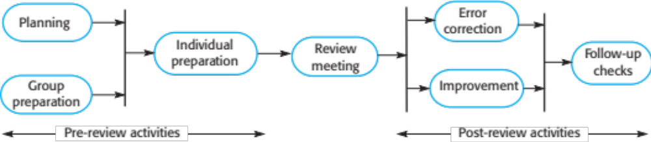
The software review process

Slide 164
Distributed reviews
The processes suggested for reviews assume that the review team has a face-to-face meeting to discuss the software or documents that they are reviewing.
However, project teams are now often distributed, sometimes across countries or continents, so it is impractical for team members to meet face to face.
Remote reviewing can be supported using shared documents where each review team member can annotate the document with their comments.

Slide 165
Program inspections
These are peer reviews where engineers examine the source of a system with the aim of discovering anomalies and defects.
Inspections do not require execution of a system so may be used before implementation.
They may be applied to any representation of the system (requirements, design,configuration data, test data, etc.).
They have been shown to be an effective technique for discovering program errors.

Slide 166
Inspection checklists
Checklist of common errors should be used to
drive the inspection.
Error checklists are programming language
dependent and reflect the characteristic errors that are likely to arise in the language.
In general, the 'weaker' the type checking, the larger the checklist.
Examples: Initialisation, Constant naming, loop
termination, array bounds, etc.

Slide 167
An inspection checklist (a)
Fault class | Inspection check
Data faults | Are all program variables initialized before their values are used? Have all constants been named? Should the upper bound of arrays be equal to the size of the array or Size -1? If character strings are used, is a delimiter explicitly assigned? Is there any possibility of buffer overflow?
Control faults | For each conditional statement, is the condition correct? Is each loop certain to terminate? Are compound statements correctly bracketed? In case statements, are all possible cases accounted for? If a break is required after each case in case statements, has it been included?
Input/output faults | Are all input variables used? Are all output variables assigned a value before they are output? Can unexpected inputs cause corruption?

Slide 168
An inspection checklist (b)
Fault class | Inspection check
Interface faults | Do all function and method calls have the correct number of parameters? Do formal and actual parameter types match? Are the parameters in the right order? If components access shared memory, do they have the same model of the shared memory structure?
Storage management faults | If a linked structure is modified, have all links been correctly reassigned? If dynamic storage is used, has space been allocated correctly? Is space explicitly deallocated after it is no longer required?
Exception management faults | Have all possible error conditions been taken into account?

Slide 169
Quality management and agile development

Slide 170
Quality management and agile development
Quality management in agile development is informal rather than document-based.
It relies on establishing a quality culture, where all team members feel responsible for software quality and take actions to ensure that quality is maintained.
The agile community is fundamentally opposed to what it sees as the bureaucratic overheads of standards-based approaches and quality processes as embodied in ISO 9001.

Slide 171
Shared good practice
Check before check-in
  Programmers are responsible for organizing their own code reviews with other team members before the code is checked in to the build system.
Never break the build
  Team members should not check in code that causes the system to fail. Developers have to test their code changes against the whole system and be confident that these work as expected.
Fix problems when you see them
  If a programmer discovers problems or obscurities in code developed by someone else, they can fix these directly rather than referring them back to the original developer.

Slide 172
Reviews and agile methods
The review process in agile software development is usually informal.
In Scrum,, there is a review meeting after each iteration of the software has been completed (a sprint review), where quality issues and problems may be discussed.
In Extreme Programming, pair programming ensures that code is constantly being examined and reviewed by another team member.

Slide 173
Pair programming
This is an approach where 2 people are responsible for code development and work together to achieve this.
Code developed by an individual is therefore constantly being examined and reviewed by another team member.
Pair programming leads to a deep knowledge of a program, as both programmers have to understand the program in detail to continue development.
This depth of knowledge is difficult to achieve in inspection processes and pair programming can find bugs that would not be discovered in formal inspections.

Slide 174
Pair programming weaknesses
Mutual misunderstandings
  Both members of a pair may make the same mistake in understanding the system requirements. Discussions may reinforce these errors.
Pair reputation
  Pairs may be reluctant to look for errors because they do not want to slow down the progress of the project.
Working relationships
  The pair’s ability to discover defects is likely to be compromised by their close working relationship that often leads to reluctance to criticize work partners.

Slide 175
Agile QM and large systems
When a large system is being developed for an external customer, agile approaches to quality management with minimal documentation may be impractical.
  If the customer is a large company, it may have its own quality management processes and may expect the software development company to report on progress in a way that is compatible with them.
  Where there are several geographically distributed teams involved in development, perhaps from different companies, then informal communications may be impractical.
  For long-lifetime systems, the team involved in development will changeWithout documentation, new team members may find it impossible to understand development.

Slide 176
Software measurement

Slide 177
Software measurement
Software measurement is concerned with deriving a numeric value for an attribute of a software product or process.
This allows for objective comparisons between techniques and processes.
Although some companies have introduced measurement programmes, most organisations still don’t make systematic use of software measurement.
There are few established standards in this area.

Slide 178
Software metric
Any type of measurement which relates to a software system, process or related documentation
  Lines of code in a program, the Fog index, number of person-days required to develop a component.
Allow the software and the software process to
be quantified.
May be used to predict product attributes or to control the software process.
Product metrics can be used for general predictions or to identify anomalous components.

Slide 179
Types of process metric
The time taken for a particular process to be completed
  This can be the total time devoted to the process, calendar time, the time spent on the process by particular engineers, and so on.
The resources required for a particular process
  Resources might include total effort in person-days, travel costs or computer resources.
The number of occurrences of a particular event
  Examples of events that might be monitored include the number of defects discovered during code inspection, the number of requirements changes requested, the number of bug reports in a delivered system and the average number of lines of code modified in response to a requirements change.

Slide 180
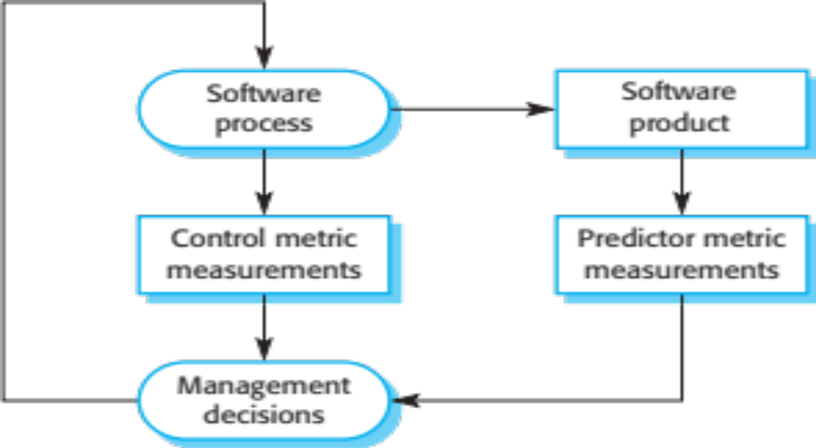
Predictor and control measurements

Slide 181
Use of measurements
To assign a value to system quality attributes
  By measuring the characteristics of system components, such as their cyclomatic complexity, and then aggregating these measurements, you can assess system quality attributes, such as maintainability.
To identify the system components whose quality is sub-standard
  Measurements can identify individual components with characteristics that deviate from the norm. For example, you can measure components to discover those with the highest complexity. These are most likely to contain bugs because the complexity makes them harder to understand.

Slide 182
Metrics assumptions
A software property can be measured accurately.
The relationship exists between what we can
measure and what we want to know. We can only measure internal attributes but are often more interested in external software attributes.
This relationship has been formalised and
validated.
It may be difficult to relate what can be measured to desirable external quality attributes.

Slide 183
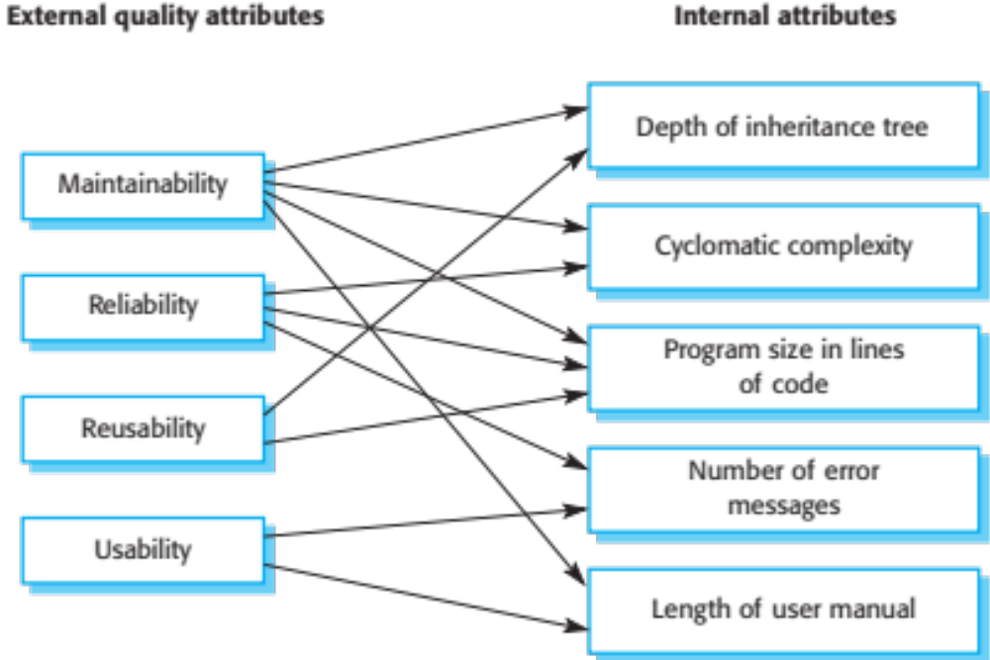
Relationships between internal and external software

Slide 184
Problems with measurement in industry
It is impossible to quantify the return on investment of introducing an organizational metrics program.
There are no standards for software metrics or standardized processes for measurement and analysis.
In many companies, software processes are not standardized and are poorly defined and controlled.
Most work on software measurement has focused on code-based metrics and plan-driven development processes. However, more and more software is now developed by configuring ERP systems or COTS.
Introducing measurement adds additional overhead to processes.

Slide 185
Empirical software engineering
Software measurement and metrics are the basis of empirical software engineering.
This is a research area in which experiments on software systems and the collection of data about real projects has been used to form and validate hypotheses about software engineering methods and techniques.
Research on empirical software engineering, this has not had a significant impact on software engineering practice.
It is difficult to relate generic research to a project that is different from the research study.

Slide 186
Product metrics
A quality metric should be a predictor of product quality.
Classes of product metric
  Dynamic metrics which are collected by measurements made of a program in execution;
  Static metrics which are collected by measurements made of the system representations;
  Dynamic metrics help assess efficiency and reliability
  Static metrics help assess complexity, understandability and maintainability.

Slide 187
Dynamic and static metrics
Dynamic metrics are closely related to software quality attributes
  It is relatively easy to measure the response time of a system (performance attribute) or the number of failures (reliability attribute).
Static metrics have an indirect relationship with quality attributes
  You need to try and derive a relationship between these metrics and properties such as complexity, understandability and maintainability.

Slide 188
Static software product metrics
Software metric | Description
Fan-in/Fan-out | Fan-in is a measure of the number of functions or methods that call another function or method (say X). Fan-out is the number of functions that are called by function X. A high value for fan-in means that X is tightly coupled to the rest of the design and changes to X will have extensive knock-on effects. A high value for fan-out suggests that the overall complexity of X may be high because of the complexity of the control logic needed to coordinate the called components.
Length of code | This is a measure of the size of a program. Generally, the larger the size of the code of a component, the more complex and error-prone that component is likely to be. Length of code has been shown to be one of the most reliable metrics for predicting error-proneness in components.

Slide 189
Static software product metrics
Software metric | Description
Cyclomatic complexity | This is a measure of the control complexity of a program. This control complexity may be related to program understandability. I discuss cyclomatic complexity in Chapter 8.
Length of identifiers | This is a measure of the average length of identifiers (names for variables, classes, methods, etc.) in a program. The longer the identifiers, the more likely they are to be meaningful and hence the more understandable the program.
Depth of conditional nesting | This is a measure of the depth of nesting of if-statements in a program. Deeply nested if-statements are hard to understand and potentially error-prone.
Fog index | This is a measure of the average length of words and sentences in documents. The higher the value of a document’s Fog index, the more difficult the document is to understand.

Slide 190
The CK object-oriented metrics suite
Object-oriented metric | Description
Weighted methods per class (WMC) | This is the number of methods in each class, weighted by the complexity of each method. Therefore, a simple method may have a complexity of 1, and a large and complex method a much higher value. The larger the value for this metric, the more complex the object class. Complex objects are more likely to be difficult to understand. They may not be logically cohesive, so cannot be reused effectively as superclasses in an inheritance tree.
Depth of inheritance tree (DIT) | This represents the number of discrete levels in the inheritance tree where subclasses inherit attributes and operations (methods) from superclasses. The deeper the inheritance tree, the more complex the design. Many object classes may have to be understood to understand the object classes at the leaves of the tree.
Number of children (NOC) | This is a measure of the number of immediate subclasses in a class. It measures the breadth of a class hierarchy, whereas DIT measures its depth. A high value for NOC may indicate greater reuse. It may mean that more effort should be made in validating base classes because of the number of subclasses that depend on them.

Slide 191
The CK object-oriented metrics suite
Object-oriented metric | Description
Coupling between object classes (CBO) | Classes are coupled when methods in one class use methods or instance variables defined in a different class. CBO is a measure of how much coupling exists. A high value for CBO means that classes are highly dependent, and therefore it is more likely that changing one class will affect other classes in the program.
Response for a class (RFC) | RFC is a measure of the number of methods that could potentially be executed in response to a message received by an object of that class. Again, RFC is related to complexity. The higher the value for RFC, the more complex a class and hence the more likely it is that it will include errors.
Lack of cohesion in methods (LCOM) | LCOM is calculated by considering pairs of methods in a class. LCOM is the difference between the number of method pairs without shared attributes and the number of method pairs with shared attributes. The value of this metric has been widely debated and it exists in several variations. It is not clear if it really adds any additional, useful information over and above that provided by other metrics.

Slide 192
Software component analysis
System component can be analyzed separately using a range of metrics.
The values of these metrics may then compared for different components and, perhaps, with historical measurement data collected on previous projects.
Anomalous measurements, which deviate significantly from the norm, may imply that there are problems with the quality of these components.

Slide 193
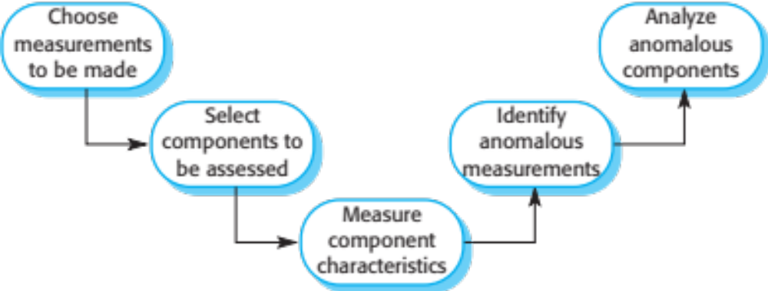
The process of product measurement

Slide 194
Measurement ambiguity
When you collect quantitative data about software and software processes, you have to analyze that data to understand its meaning.
It is easy to misinterpret data and to make inferences that are incorrect.
You cannot simply look at the data on its own. You must also consider the context where the data is collected.

Slide 195
Measurement surprises
Reducing the number of faults in a program leads to an increased number of help desk calls
  The program is now thought of as more reliable and so has a wider more diverse market. The percentage of users who call the help desk may have decreased but the total may increase;
  A more reliable system is used in a different way from a system where users work around the faults. This leads to more help desk calls.

Slide 196
Software context
Processes and products that are being measured are not insulated from their environment.
The business environment is constantly changing and it is impossible to avoid changes to work practice just because they may make comparisons of data invalid.
Data about human activities cannot always be taken at face value. The reasons why a measured value changes are often ambiguous. These reasons must be investigated in detail before drawing conclusions from any measurements that have been made.

Slide 197
Software analytics
Software analytics is analytics on software data for managers and software engineers with the aim of empowering software development individuals and teams to gain and share insight from their data to make better decisions.

Slide 198
Software analytics enablers
The automated collection of user data by software product companies when their product is used.
  If the software fails, information about the failure and the state of the system can be sent over the Internet from the user’s computer to servers run by the product developer.
The use of open source software available on platforms such as Sourceforge and GitHub and open source repositories of software engineering data.
  The source code of open source software is available for automated analysis and this can sometimes be linked with data in the open source repository.

Slide 199
Analytics tool use
Tools should be easy to use as managers are unlikely to have experience with analysis.
•Tools should run quickly and produce concise outputs rather than large volumes of information.
•Tools should make many measurements using as many parameters as possible. It is impossible to predict in advance what insights might emerge.
• Tools should be interactive and allow managers and developers to explore the analyses.

Slide 200
Status of software analytics
Software analytics is still immature and it is too early to say what effect it will have.
Not only are there general problems of ‘big data’ processing, our knowledge depends on collected data from large companies.
  This is primarily from software products and it is unclear if the tools and techniques that are appropriate for products can also be used with custom software.
Small companies are unlikely to invest in the data collection systems that are required for automated analysis so may not be able to use software analytics.

Slide 201
Key points
Software quality management is concerned with ensuring that software has a low number of defects and that it reaches the required standards of maintainability, reliability, portability etc. Software standards are important for quality assurance as they represent an identification of ‘best practice’. When developing software, standards provide a solid foundation for building good quality software.
Reviews of the software process deliverables involve a team of people who check that quality standards are being followed. Reviews are the most widely used technique for assessing quality.

Slide 202
Key points
In a program inspection or peer review, a small team systematically checks the code. They read the code in detail and look for possible errors and omissions. The problems detected are discussed at a code review meeting.
Agile quality management relies on establishing a quality culture where the development team works together to improve software quality.
Software measurement can be used to gather quantitative data about software and the software process.

Slide 203
Key points
You may be able to use the values of the software metrics that are collected to make inferences about product and process quality.
Product quality metrics are particularly useful for highlighting anomalous components that may have quality problems. These components should then be analyzed in more detail.
Software analytics is the automated analysis of large volumes of software product and process data to discover relationships that may provide insights for project managers and developers.

